Slide 1
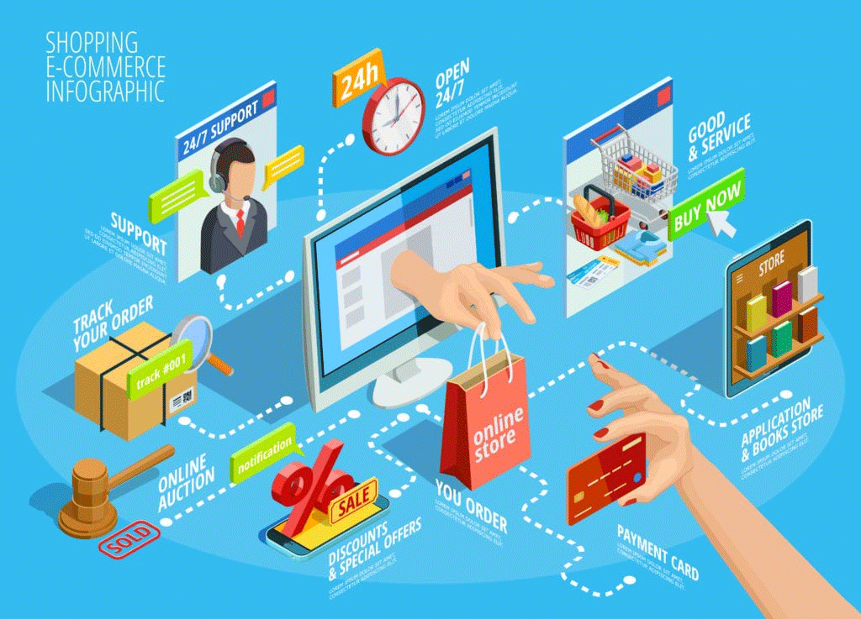

E-COMMERCE Olist store analysis
Presented by
Mr. Asrith Indukuri
Ms. Bondili Preethi Singh
Ms. Payal Uday Shrimakar
Mrs. Mounika Kedala
Mr. Shubham Doijode
Dr. Fozia Mehtab
Mr.Adhyayan Dattatray Tikole

Slide 2

AGENDA
OBJECTIVE
DATA OVER VIEW
ORIGINAL DATA
ETL PROCESS
ANALYTICAL INSIGHTS
DASHBOARD DEMO
RECOMMENDATIONS

Slide 3



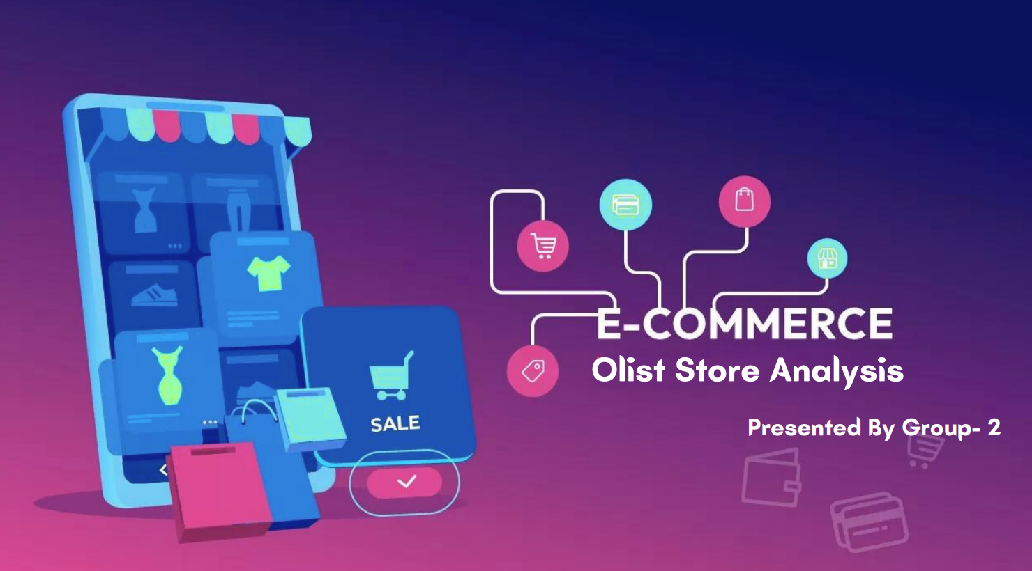



OVERVIEW
Olist is an e-commerce platform that connects small and medium-sized business to customers.
The Olist Store Analysis project aims to analyse customer purchasing patters and payment statistics on E-Commerce platform.
This presentation will dive into important insights and statistics derived from Olist Data.

Slide 4
Objective
Revenue for Each State: Analyzing the revenue received by Olist from each state, helps in understanding the revenue contribution of each region.
Monthly Revenue: Identify Olist’s monthly revenue trends to assist in financial planning and business growth.
Total Revenue per Each Product Category: Calculated the total revenue earned by each product category to estimate the relative contribution of each category.
Payment Installment: Analyze payments made in installments to identify term payment patterns.
Average Price over Time by Product Category: Understand the average change in product prices over time within each product category.
Top 10 Customer State Capacity: Identifying the ten states with the largest customer capacity helped Olist identify the most potential regions.

Slide 5
DATA OVER VIEW
Client Scenario
Current pain points
Future Impact
Scattered data through multiple flat files
Reduce data storage redundancy
Database Normalization
ETL process
Analytical insights
Inefficient information query process
Create efficiency data query and analytics procedure
Lack of analytics insights to make business decisions
Create a relational database
Data manipulation & data cleaning
Loading data to server & Interactive dashboards
Empower data driven decision making capability

Slide 6
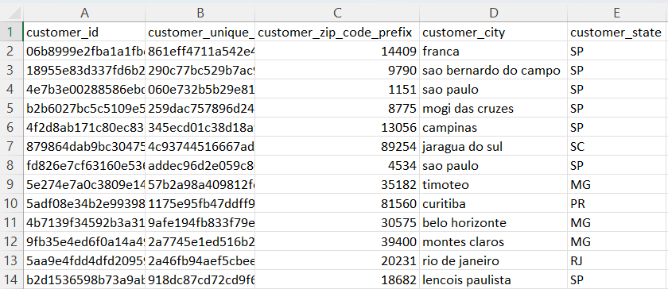
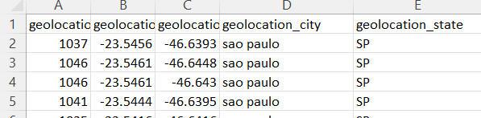
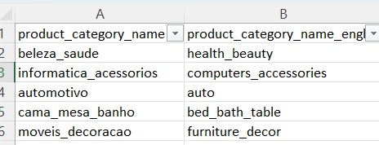
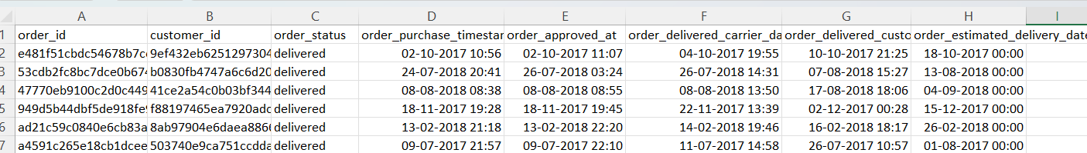
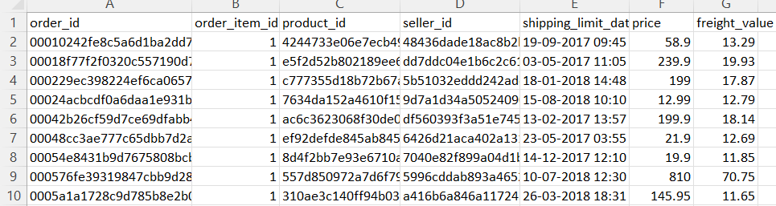
Original Data
Data Over View
Data consists of 99441 orders
9 CSV files with 120 MB of storage
Repetitive columns are seen
Geo-Location
Customer File
Too large file sizes to merge
Different Languages
Underlying duplicates are difficult to merge
City & State are seen in 2 data sets with customer city & geolocation city they can’t be merged or deleted by removing duplicates
In some cases for connecting a table like review dataset it required some other tables to be merged due to improper columns
Scattered data with multiple files

Slide 7
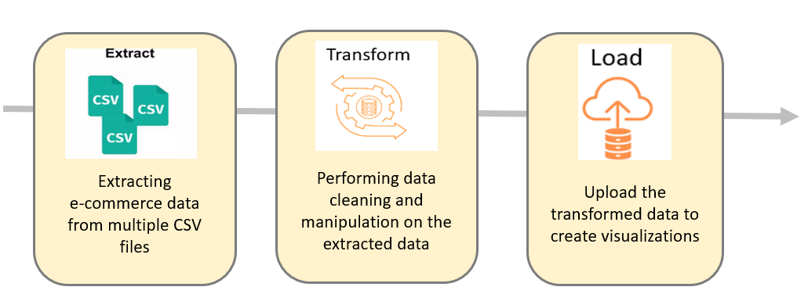
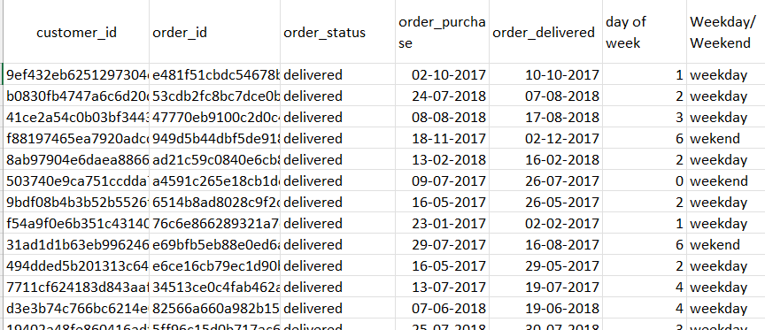
ETL PROCESS
Added new column on cust_id in orders dataset
Column type is changed
De-brief of ETL Process
Step 1 | Extract, rename and reorder the columns
Step 2 | Get the relevant data by merging datasets
Step 3 | Drop duplicate entries
Step 4 | Ensure unique and primary key columns in each table
Step 5 | Construct variables
Step 6 | Merge data sets and drop unnecessary columns and rename columns
Step 7 | Change data types
New columns are added

Slide 8
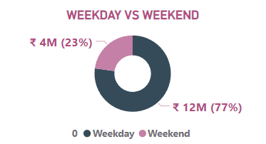
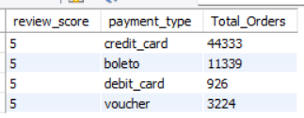
KPI’s
Weekday Vs Weekend Payment Statistics
the analysis reveals weekday sales outperform weekend sales
To enhance weekend sales performance, strategic initiatives such as targeted advertising campaigns, diverse promotional activities, and discounts maybe implemented
Number of Orders with review score 5 and payment type as credit card.
Olist can use this information to implement loyalty programs specifically tailored for credit card with high review scores.
A significant percentage of orders with high review score are associated with credit card payments, indicating customer satisfaction and trust in the payment method

Slide 9
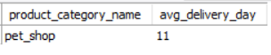
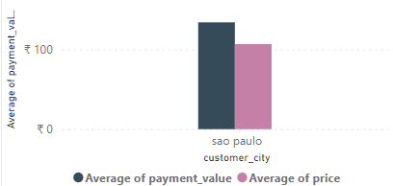
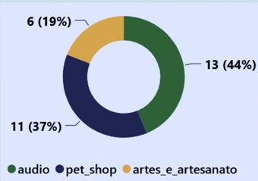
Average number of days taken for order delivered for pet shop
Average price and payment values from customers of Sao Paulo city
The average no of days taken for order delivery for pet items is within an acceptable range, indicating efficient logistics ad fulfilment processes.
It helps Olist in identifying areas where they can improve their delivery time and maintain customer satisfaction
It helps in analyse pricing strategy to ensure that products are competitively priced within the Sao Paulo market. Conduct market research to understand pricing accordingly, Introduce new products or services that align with the preferences and purchasing power of Sao Paulo customer.

Slide 10
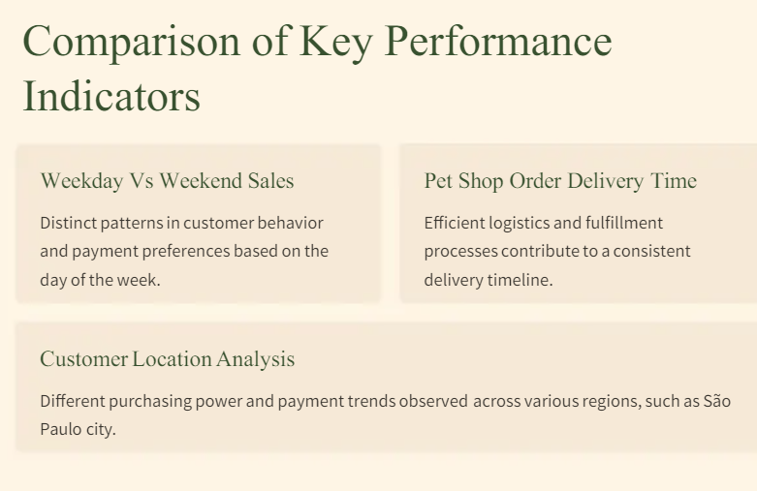
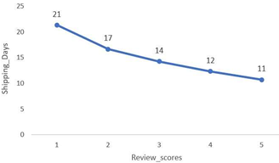
Shipping days Vs Review scores
It evaluates the correlation b/n shipping duration and review rating.
It helps to understand delivery tome and customer satisfaction

Slide 11
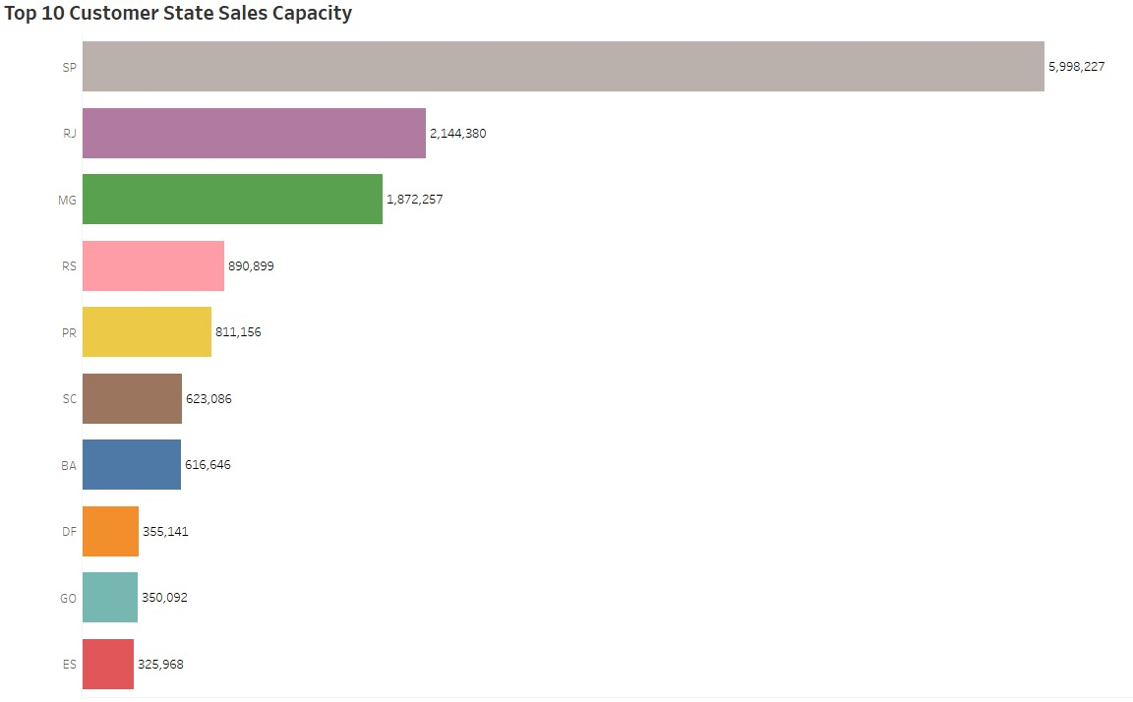
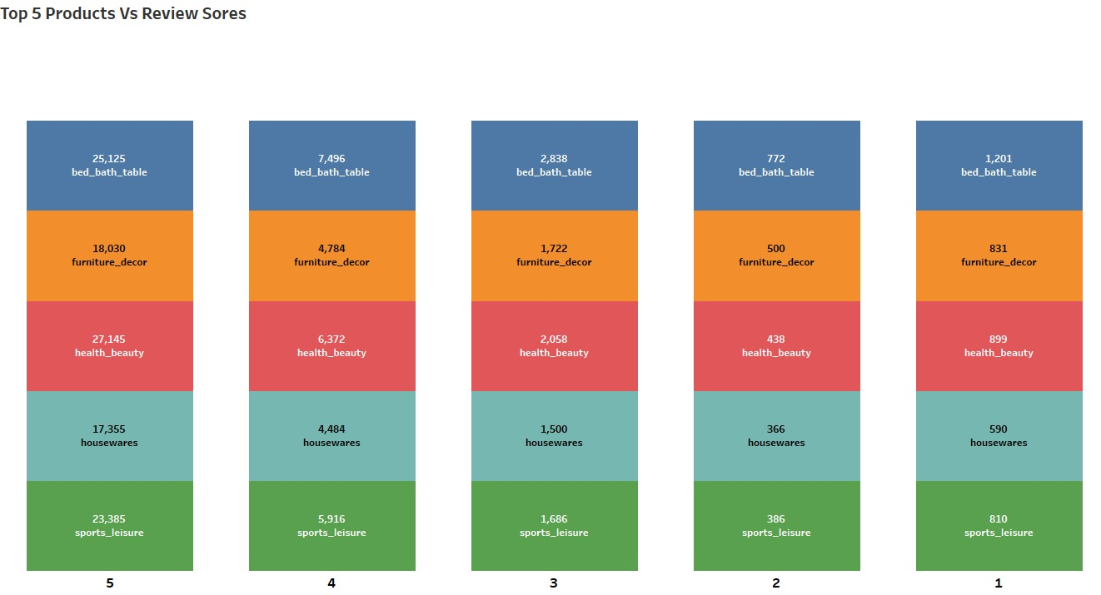
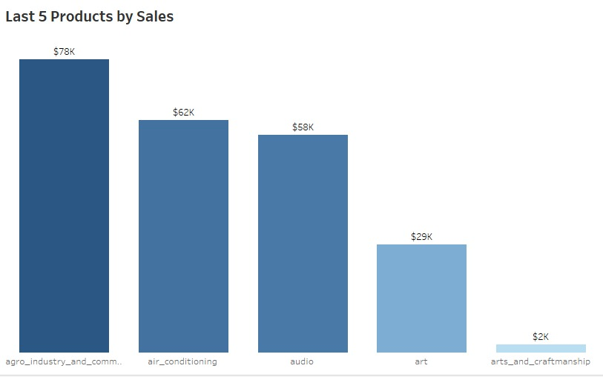
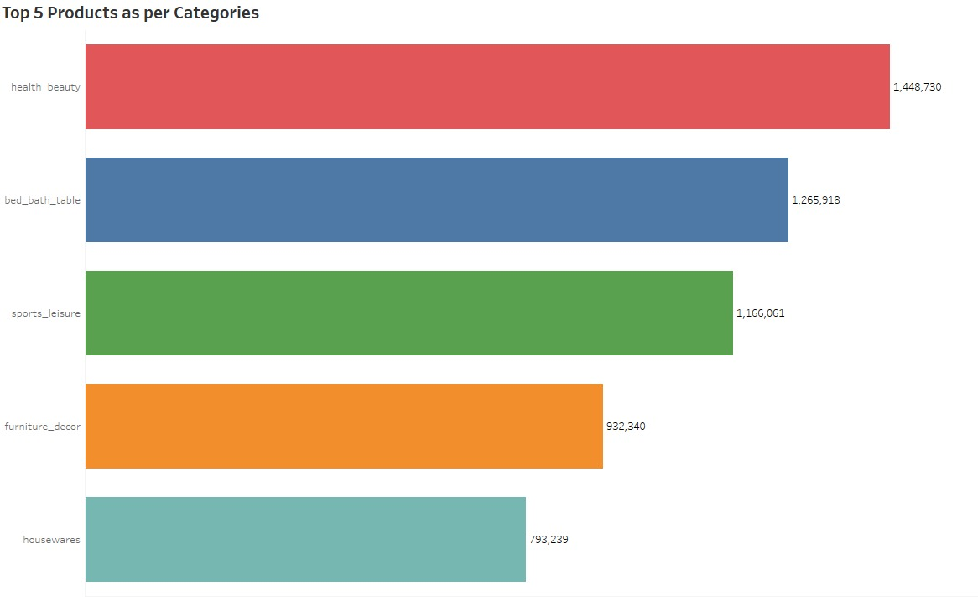
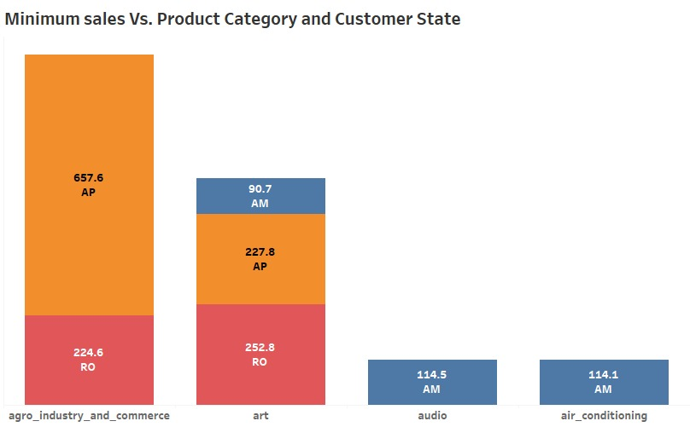
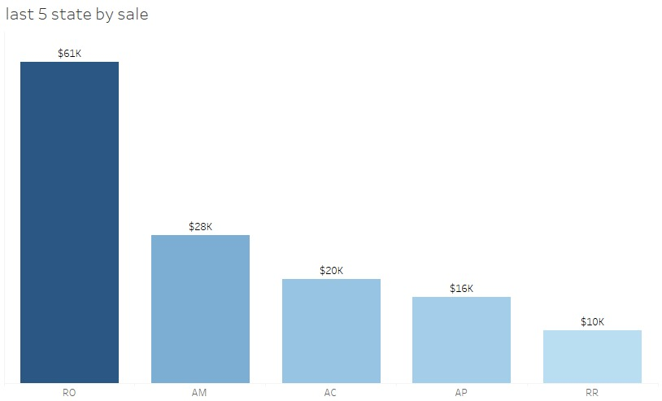
Top & least things of Olist

Slide 12
Insights
Insights can help in making business decisions, such as focusing on products that customers are interested in, improving product and service quality, and optimizing marketing in providences with high sales.
In addition, this analysis also provides an overview of customer consumption trends and patterns that can be used to direct further business strategies.
According to the data, Olist E-Commerce has about 99,441 orders with 90% delivery rate.
Average rating is 4 & low rating is 2, few items have lowest rating 1
Delivery performance can also influence review scores and success rate could certainly improved

Slide 13
recommendations
Regularly monitor and analyse customer reviews to gain insights in product quality and identify areas for improvement.
Dashboards can be used to identify patterns in customer reviews & this will provide enhancing customer experience,.
Check that all products are of good quality by regularly inspecting them and the suppliers who provide them
Work on getting orders to customers quicker and more reliable
Pay attention to what customers are saying, especially if they’re not happy. Use their feedback to fix any problems and make things better for everyone.
Show-off positive reviews and ratings from happy customers to let others know how great products and service are. This helps attract more customers and help them coming back.

Slide 14
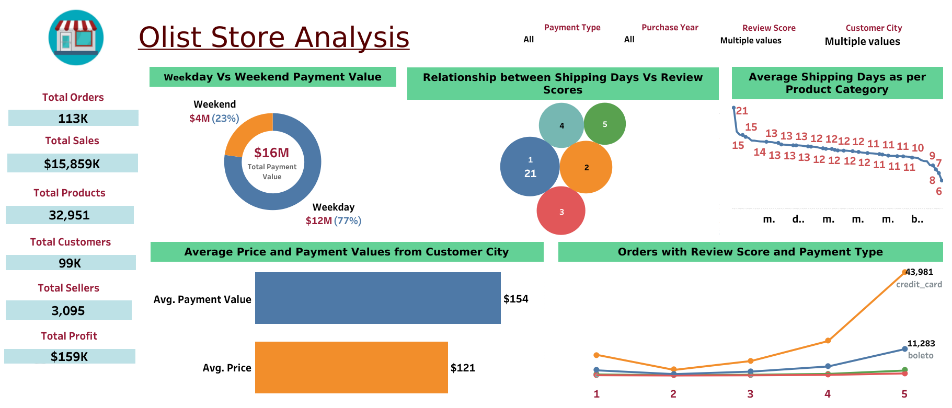
Dashboard demo

Slide 15

Group -3

